Slide 1
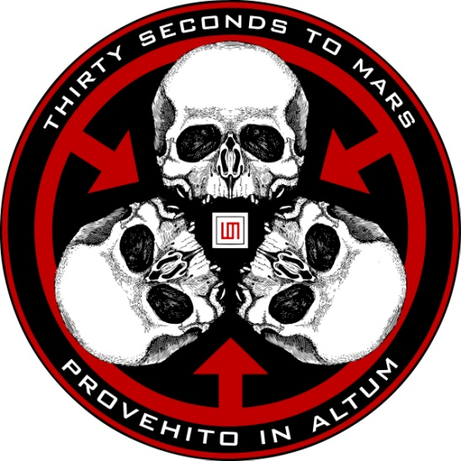
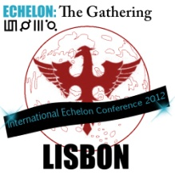
Mars Mythology
Symbols: suggested meanings of the glyphs. Self titled, ABL and This is War era.
New symbols
Rita Guerra & Tiago Ruivinho

Slide 2
The Glyphs
The current set of glyphs is considered to be the "original" one, in the sense that these specific glyphs seem to be a creation of the band. They do not bear the same similarities to ancient script as the first set of glyphs.
30 Seconds to Mars have always been oblivious to what any of the symbols mean. So what follows is an Echelon interpretation, based on multiple theories from the community — specially those discussed and presented thorough the years on the official 30STM forum.

Slide 3
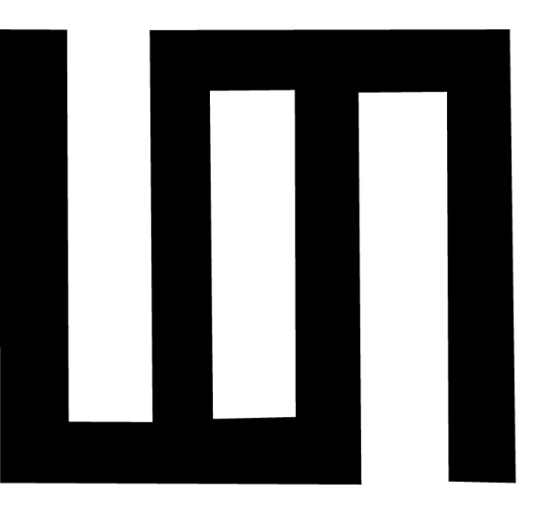
Mars Mythology
The first glyph is composed by two intertwined 3. Such combination provides a hole in the middle, composing "30", the first word (number) in the band's name.

Slide 4
Mars Mythology
The second glyph is a circle with clock hands, which are pointing counterclockwise. It represents Seconds.

Slide 5
Mars Mythology
The third glyph is the inverted Romanic symbol for 2: II (as a negative picture) which in English is read "two" - "to"

Slide 6
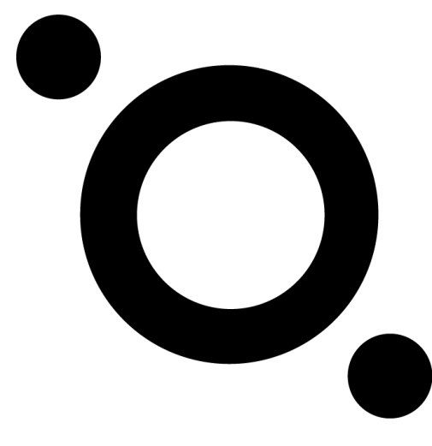
Mars Mythology
The fourth glyph represents Mars with its two moons around, Phobos and Deimos.
So you have a very literal representation of Thirty Seconds To Mars.

Slide 7
But.... What if there is another meaning?
The first glyph would be a pictograph of the two Letos: Leto x2, Leto-Leto entangled.
It is the same viewed from the top and bottom, resembling China's Yin-Yang: male/female, assertive/receptive. Creativity needs both to be completed: Jared and Shannon share that . None is top or bottom, energy flows between them.

Slide 8
Mars Mythology
Each glyph may stand for one of the four terrestrial planets: the first for Mercury; the second Venus, rotating in the opposite direction; the third is the Earth - third planet from the sun; and the fourth is Mars.

Slide 9
The first set of glyphs
These are referred to as “iberian glyphs" or “norse runes”, as they look similar to the ancient iberian script
Runic writing was used in southern Europe and was carried North. The band may have adapted these symbols, which are thousand of years old, giving them a meaning we do not know.

Slide 10
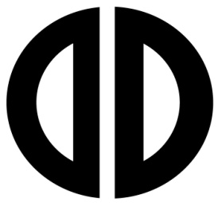
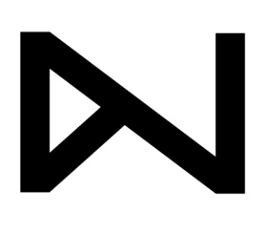
The iberic alphabet

Slide 11
Portugal & Spain
All astrological and alchemy symbols are based in this Mediterranean alphabet. So the place we are standing in today is deeply connected to the Mars mythology.

Slide 12
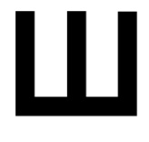
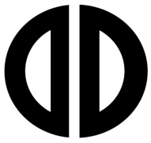
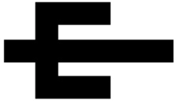
What do they mean?
First glyph is Jupiter
The second is a broken time glass
The third is the moon
The fourth is Neptune

Slide 13
Really? Or...
The third glyph may also mean active intellect“ opposing the next one 3 lines crossed meaning "disordered intellect".

Slide 14
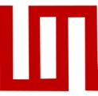
Mars is... Music
What if both sets of glyphs compose a musical scale? The first glyph of both sets is similar and may be a musical note. A music scale has 7 notes and the 8th is a repetition. So the glyph that we think is "30" may just be a superimposition of the iberic glyph:
+ =

Slide 15
However...☺
If you read the glyphs for what they look like
it says ENDE
And they are placed at the END of the CD.

Slide 16
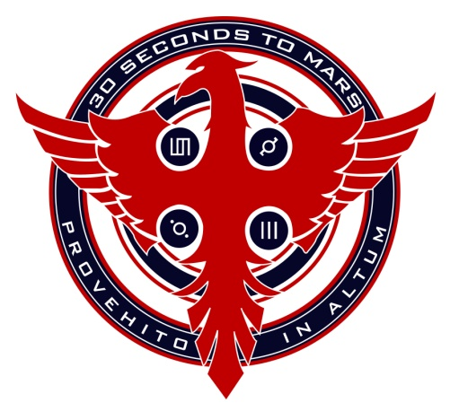
PHOENIX (MITHRA)
The Mithra is an adaptation of the Phoenix, a giant, sacred bird, that represents the Sun in egyptian mythology. This bird would die at night and be reborn at sunrise, having beautiful gold and red feathers and living for 500 years.
At the end of this time, the bird would build a nest, light it and throw itself into the flames; from the ashes, a new Phoenix was born. So the meaning is: life, rebirth and immortality.
The Phoenix also represents the highest stage of
evolution of the sign Scorpio, which symbolizes life and death.

Slide 17
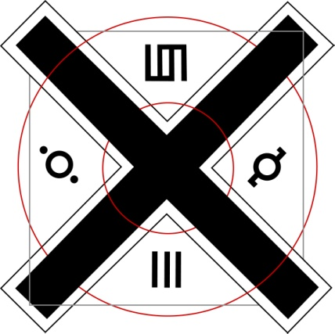
ECHELON x CROSS
The ECHELON Symbolism
- ECHELON means to attack in waves. It's a military term which was used by Napoleon during the Napoleonic wars. The term was to attack "En Echelon", (in waves). Echelon word itself means waves, which would make sense in the song "Echelon" - when the song goes "What's with the fascination with the Echelon".
- The X is a mathematical symbol for multiplication. In a spatial sense, it symbolizes diversity / versatility - "united under one banner," and is therefore used as a symbol for the Echelon. It marks the point of a hidden heart, and it is the goal for a personal seek. So, the
X Cross symbolizes the union around the band.

Slide 18
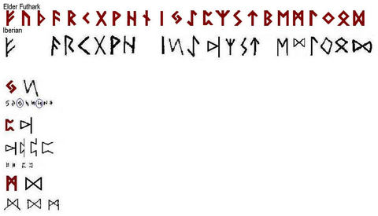
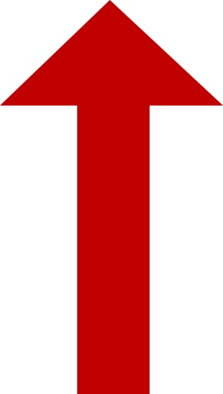
The Arrow
This might be the Tîwaz or Teiwaz Rune, named after the Norse god Tyr. The Rites of Odin by Ed Fitch says that Tyr is "the invincible warrior of the Nordic pantheon, and far older than all the others of Asgard“

Slide 19
Provehito in Altum
The upwards arrow is also a visual representation of PROVEHITO IN ALTUM = Launch forth into the deep. Reach for the highest
The Tyr rune means motivation and determination; direction and ambition, a desire for progression or advancement
“It denotes victory in battle, divine justice, honor, and represents martial values and attributes. It brings to the wearer strength of purpose, power of will and a drive to a higher purpose. This rune was once carved on weapons to bring victory, and even now it's considered by some to be particularly useful to anyone involved in a physical, legal, or moral conflict”

Slide 20
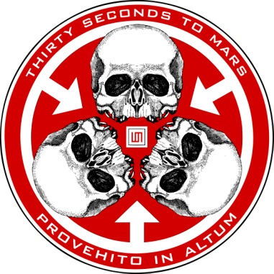
Trinity
The Trinity
The three skulls represent the Trinity of Mind, Body and Soul. So, along with the arrows, the Trinity symbol basically means that when you do something, you should do it with your everything and be devoted to the fullest, if you truly believe in it.

Slide 21
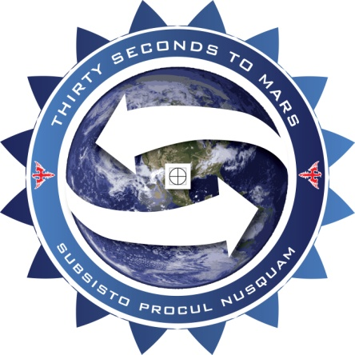
SUBSISTO PROCUL NUSQUAM
SUBSISTO : to stand, withstand, stop, halt, cease, stay. To be there. PROCUL: far, at, to, from a distance. NUSQUAM: nowhere, on no occasion. Nowhere in no place. Nothing for nothing. Never.
So: Stop at Nowhere. Stop At Nothing. .

Slide 22
BUT
There are other possible meanings, like “To be far from nowhere/anywhere”. Maybe Greenland? A reference to A Beautiful Lie theme?
The two arrows mimic the recycling symbol. The whole thing might be: Stop at nothing in saving the Earth. Let’s get sustainable, Echelon ☺

Slide 23
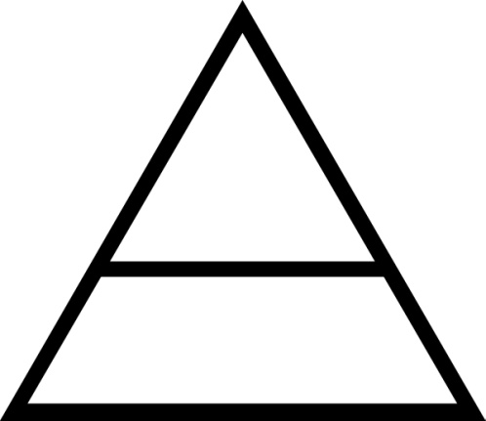
Triad
The triad appeared on the THIRD album
One of the 5 elements described by Plato was the tetrahedron. Meaning fire. Which is the equivalent of planet MARS in astronomy.

Slide 24
The triangle is one of the strongest of all geometric forms. Force is distributed evenly across all sides when pressure is applied
This is like the band: only gotten stronger in spite of all the trouble they faced.
Some have said that the three sides of the triangle represent the members of the band
The middle line probably represents The ECHELON , because it provides additional support and strength.

Slide 25
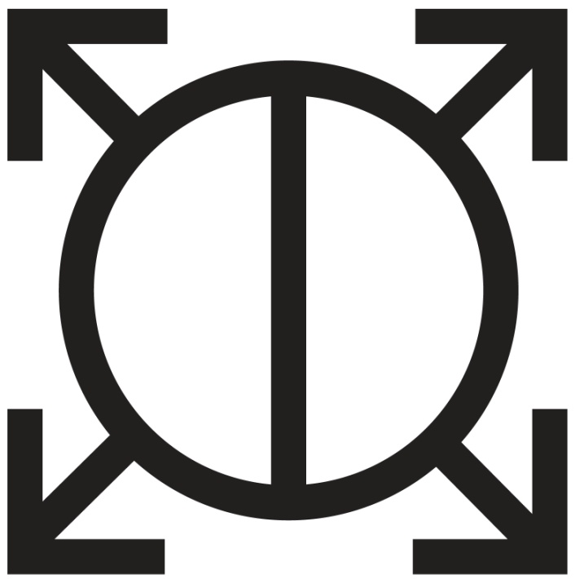
Orbis Epsilon
It uses previous symbols to create a new one: A round shape, divided in the middle (yin/yang), with spears (arrows)
It’s a symbol for War and a shield.
Epsilon is also the lowest of five castles in the novel "Brave new World"
Small and circular formation of troops.

Slide 26
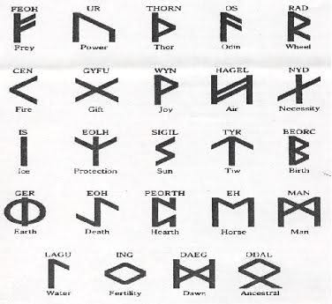
The circle being split is the rune symbol for EARTH

Slide 27
ORBIS EPSILON
Orbis means circle (Earth/World)
Epsilon is the 5th letter of the Greek alphabet, our E. Epsilon means in Greek "simple E"; a second meaning is "an arbitrary small positive quantity, in mathematical analysis".
So we have: a circle of small positive quantity, a simple E…

Slide 28
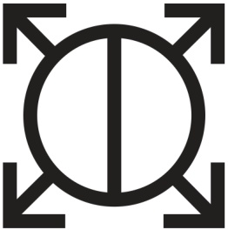
What?
... a simple circle of ECHELON

Slide 29
Thank you to everyone that spent hours analyzing #MarsSymbols, like Aitana, Mamanchat, Rothalion, Elvira, Jeto and all the others on the thirtysecondstomars.forumsunlimited.com
Our research has had multiple contributions and it’s amazing how passionate people are about Mars. It’s a fascinating reading and you should all go take a look.

Slide 30
To be continued...
[Here we are searching for a sign]

